Slide 1
Smurf Detection In Valorant
Jovin Louie, Samarth Sridhara, Iain Hennington
ECS 111 June 5, 2024

Slide 2
What is Valorant?
Tactical 5v5 (10 players in a match) competitive multiplayer shooter
Attackers vs. Defenders
Attackers attempt to plant a bomb on a site and set it off
Defenders defend sites and defuse the bomb
Played in rounds, at halftime (12 rounds), teams switch defending/attacking
Each player plays as an “agent” with special abilities
Notes:
15 seconds max

Slide 3
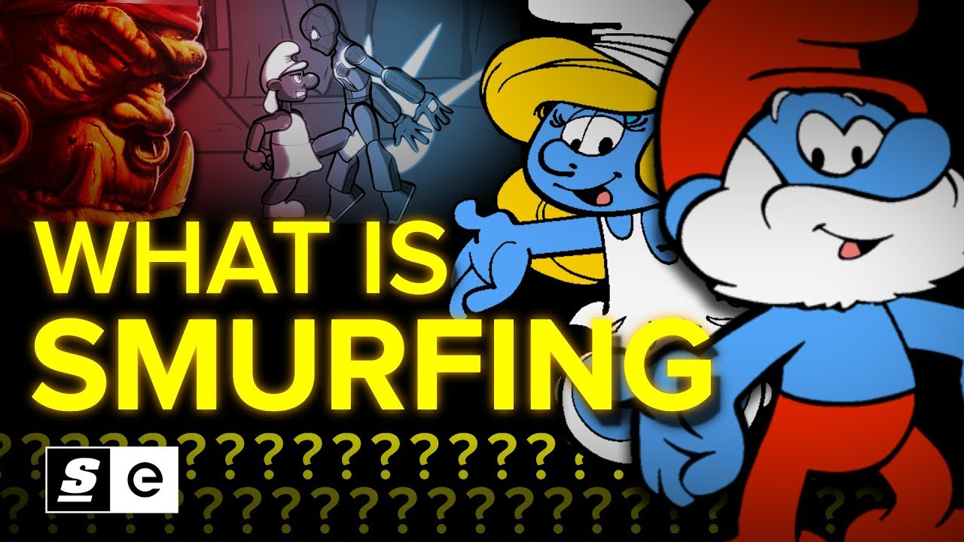
What Are Smurfs?
Players in competitive multiplayer video games who play on alternative accounts purposefully to play against lower ranked players
Imagine Lebron James disguised, and playing basketball against a bunch of elementary school students
Smurfs end up hurting the ranked systems of video games by making teams unbalanced
Notes:
15 seconds max

Slide 4
Data Gathering → Getting Real Players
Start at a player, go into their most recent match
Gather the other usernames and user IDs in that match
Repeat process on players that just had their usernames grabbed
Initial player
Player 1 from initial player’s most recent match
Player 2 from initial player’s most recent match
Player N from initial player’s most recent match
…….
….
…
Player M in player 1’s lobby
….
…
Player M in player 2’s lobby
Skip dupes, stop at 800 users
Notes:
20 seconds max

Slide 5
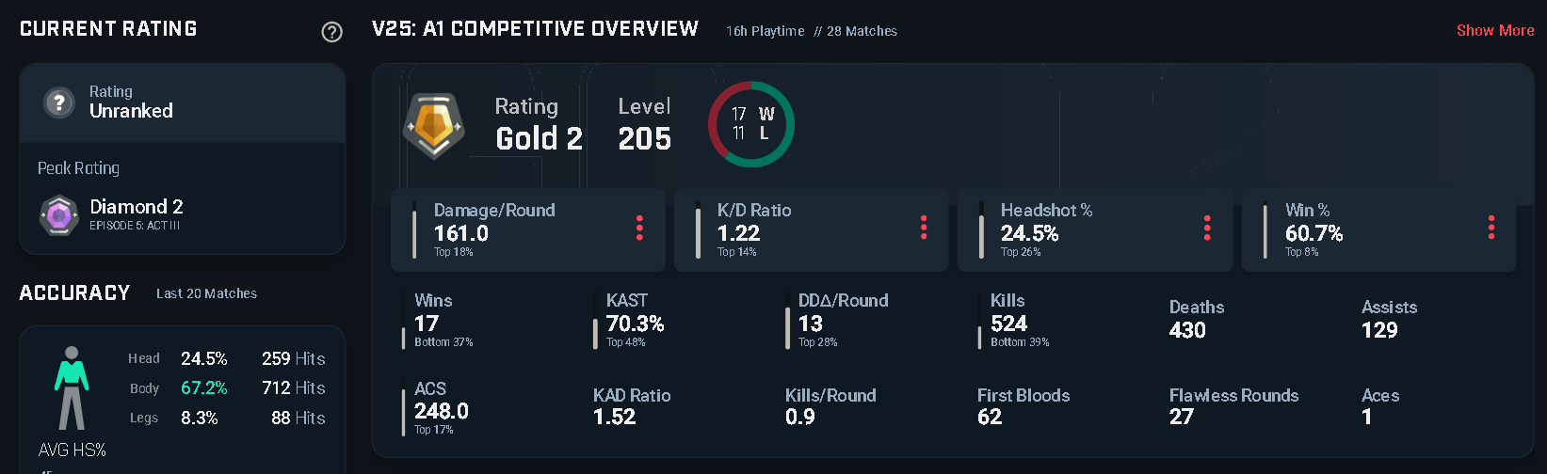
Data Gathering - Scraping Player Data
Traverse through dataframe of usernames and user IDs, web scraping data on Tracker.gg by entering username and user ID in URL
Notes:
20 seconds max

Slide 6
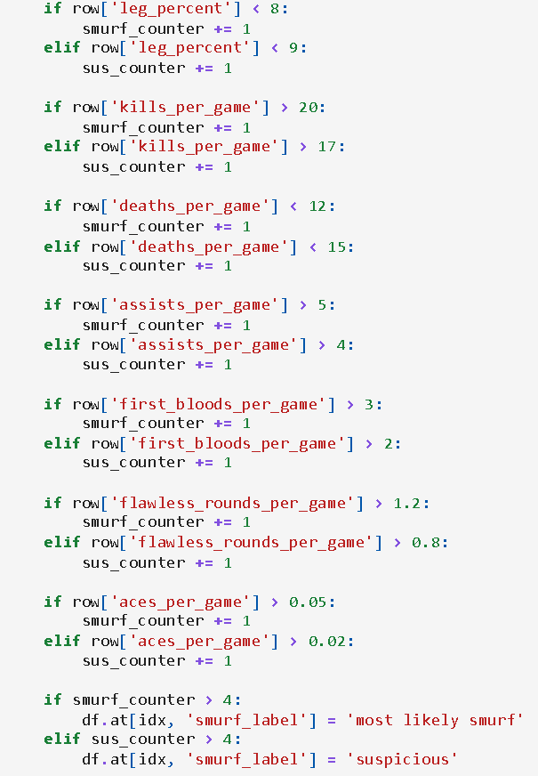
Data Labeling → Rule Based System
How do we quantify a smurf?
Using player “west virginia #9999”, pro player Jay “Sinatraa” Won’s smurf account to model our rule based system
Notes:
20 seconds max

Slide 7
Data Preprocessing
Added NA Values to Blank Values
One-hot encoded values for easier test/training of models
Winsorized Columns at thresholds of 0.05, and 0.95 to remove extreme outlier cases
Removed any other outliers through Isolation Forest at the 0.01 percent threshold
Normalized Values using StandardScaler
Imputed Missing Values using Medians
Split Models into Training/Test Files

Slide 8
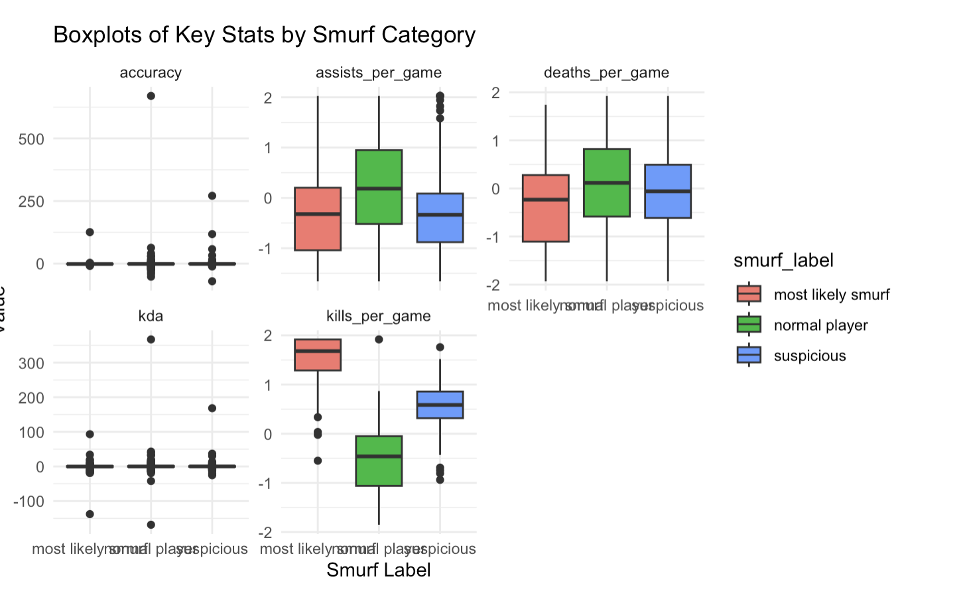
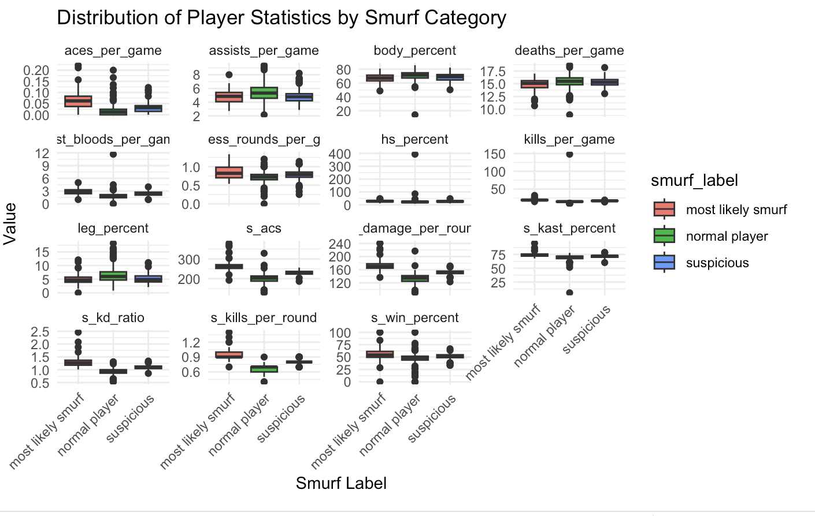
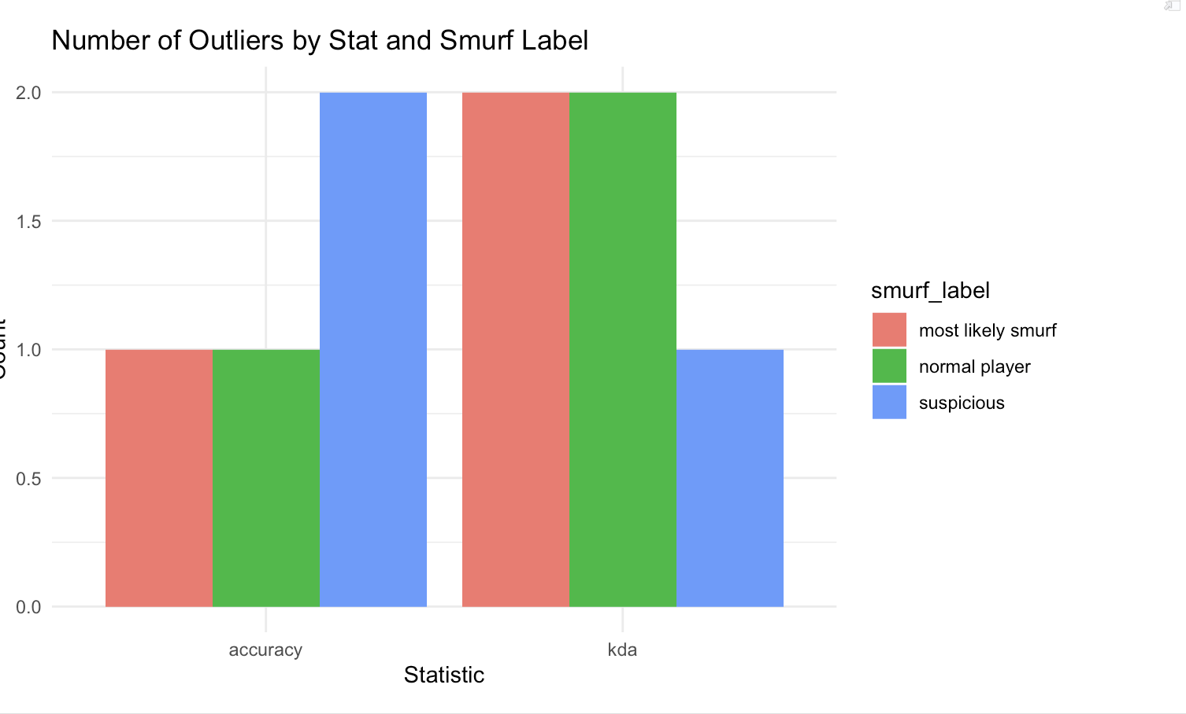
Data Pre-Processing-Visualizations
These are the Visualizations for some of the different Categories after pre-processing.

Slide 9
Model Development
Goal: Predict whether a Valorant player is a normal player, suspicious, or a likely smurf using tabular data.
Labels assigned using rule-based comparisons to known smurfs (ex: Sinatraa’s alt).
Model training used an 80/20 stratified split and 5-fold cross-validation for evaluation consistency.
354 training
88 testing
Evaluated traditional machine learning models:
Logistic Regression
Decision Tree
Random Forest

Slide 10
Model Development
Logistic Regression:
Chosen as a baseline due to its simplicity and interpretability.
Assumes a linear relationship between stats and player labels.
Decision Tree:
Enables intuitive rule-based reasoning.
Useful for modeling non-linear decision boundaries and interaction effects.
Random Forest:
Chosen for its power in handling complex, noisy tabular data.
Reduces overfitting via ensembling and can capture deeper statistical patterns.

Slide 11
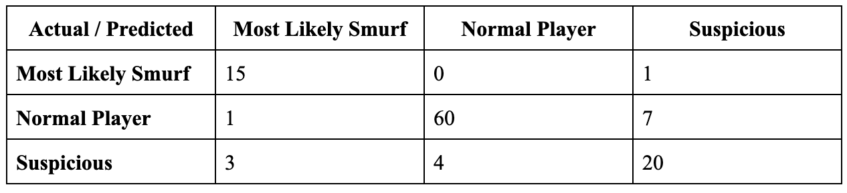
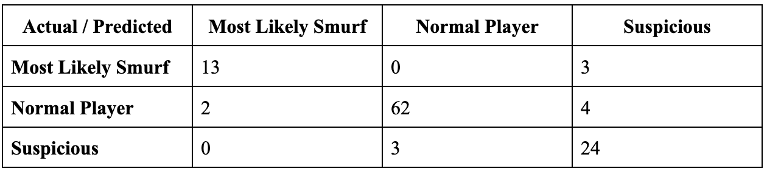
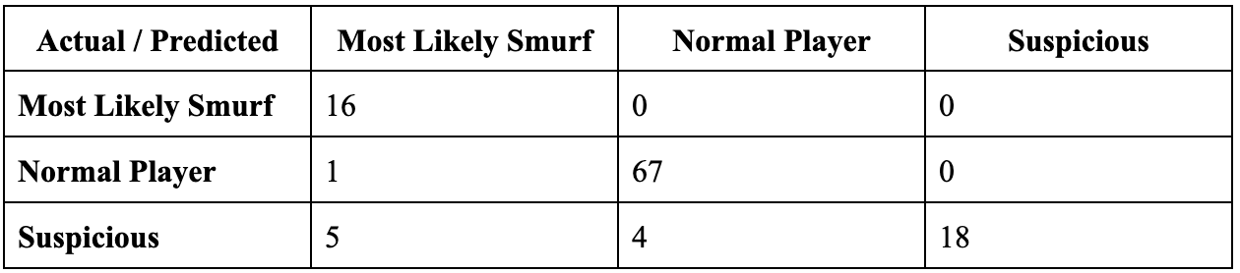
Model Development
Logistic Regression
Accuracy: 85.6%
Macro F1: 0.831
Weighted F1: 0.857
Decision Tree
Accuracy: 89.2%
Macro F1: 0.866
Weighted F1: 0.893
Random Forest
Accuracy: 91.0%
Macro F1: 0.870
Weighted F1: 0.910

Slide 12
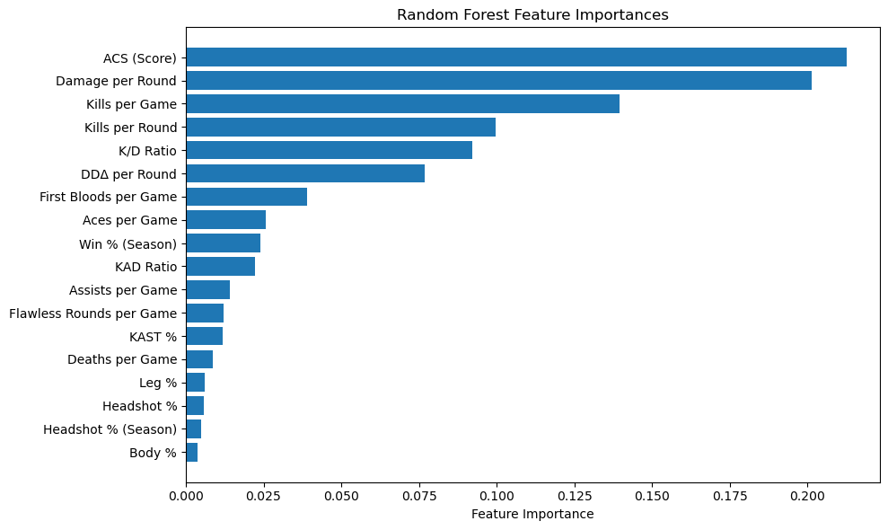
Results
Random Forest was the best overall model
Perfect recall for “Smurf” class (100%)
High precision for “Suspicious” class (100%), but recall = 67%
Decision Tree was a close second
Better at identifying “suspicious” accounts with 88.9% recall

Slide 13
Conclusion
Strong model performance overall:
All three models achieved high recall rates, averaging over 70%, indicating that smurf behavior can be detected using tabular data.
Limitations in data and labeling:
The dataset was limited to a single region, relied on one control smurf player, and used subjectively defined labels, which may impact generalizability and long-term reliability.
Ethical considerations should be addressed:
Monitoring behavioral patterns raises data privacy concerns, and false positives could lead to unfair treatment of legitimate players.
Future improvements possible:
Incorporating semi-supervised learning could help improve label accuracy and better utilize unlabeled data for enhanced model performance.

Slide 14
Thank You for Listening!

